Slide 1


HACKERCAMP’22
By
Ankit Kandpal

Slide 2
Background: Healthy living is a way of living that helps you enjoying more aspects of your life. With increasing prevalence of life-style diseases in india , one out of four Indians is dying from non-communicable diseases such as diabetes, cardio-vascular ailments or cancer before age of seventy.
A Healthy Signals is an application which send signals to the user when they are overwork or in the zone of unhealthy lifestyles.
Objective: We need a mobile/web app that will allow sending signals to the user when they are in unhealthy state or following unhealthy lifestyles.
PROBLEM STATEMENT

Slide 3
APPROACH & TECH STACK USED
Since the Problem statement emphasizes the problem of creating a solution to healthy lifestyles for a vast audience by generating signals and automating, as manual inputs are too tidy nowadays.
Connects all the devices using Bluetooth which user uses on daily basis like pc, smart watches and their working laptops with the application Healthy Signals and using that try to collects data like how much duration a user continuously working , heartrate, distance walks, sleep time, blood pressure rate and stored all of these in database using these data we generates signals using some algorithms and also suggest some health oriented exercise and practices and also weekly and monthly health report.
TECH STACKS:- Reactjs, Nodejs, Expressjs, Mongodb.

Slide 4
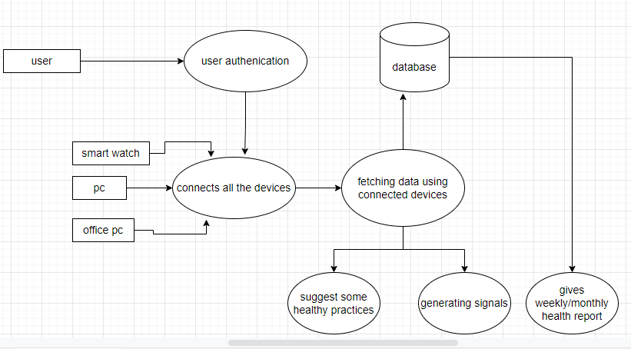
FLOWCHART OF APPLICATION

Slide 5
THANKS

